Slide 1
Multiple Linear Regression….
But First….
Review …
Simple Linear Regression!!!

Slide 2
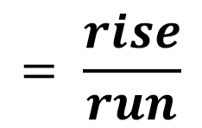
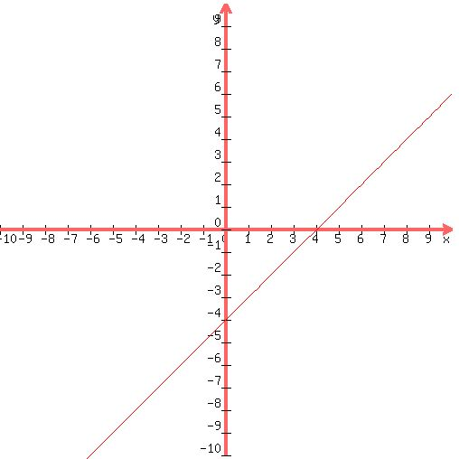



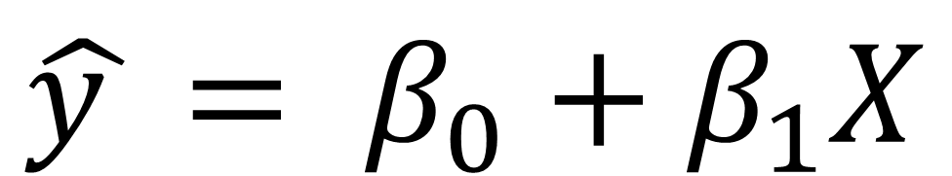
Equation of a Line!!!
$$\hat{y }= β_{0}+β_{1}X$$

Slide 3
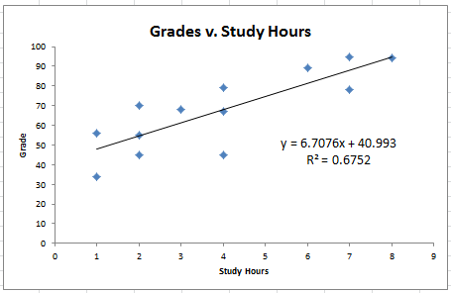
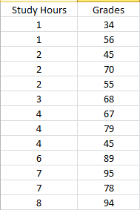
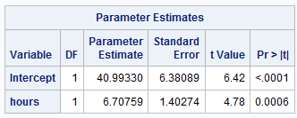


Study Hours
Grade = 40.993 + 6.7076 * Hours
t_{.025,11}= 2.201
Intercept: Although this was extrapolation, it makes sense to talk about 0 study hours and we actually measured 1 study hour. We are 95% confident that at 0 study hours, the student’s mean grade will be between 26.95 and 55.04 points; our best estimate is the y-intercept: 40.993 points.
Slope: We are 95% confident for every additional hour studied, a student’s predicted grade will increase between 3.62 and 9.79 points. Our best estimate given the data is the slope: 6.707 points.
$$40.993 ±2.201 ∗6.381=(26.95,55.04)$$
$$6.708 ±2.201 ∗1.403=(3.62, 9.80)$$

Slide 4
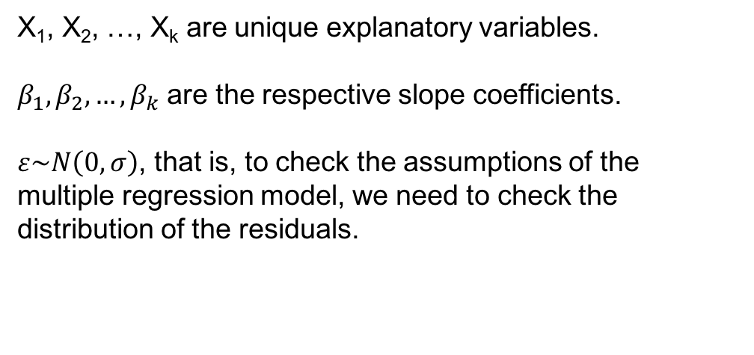
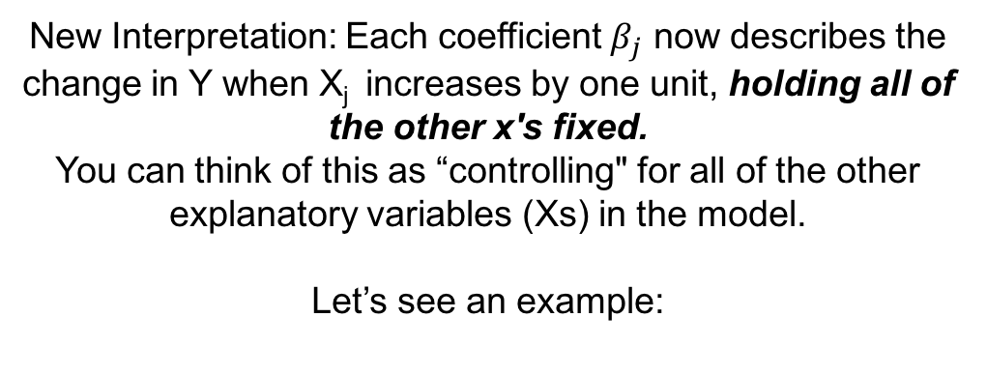
Multiple Regression
$$y= β_{0}+β_{1}X_{1}+β_{2}X_{2}+…+β_{k}X_{k}+ε$$
X₁, X₂, …, X_{k} are unique explanatory variables.
$β_{1},β_{2},{…, β}_{k}$ are the respective slope coefficients.
$ε\sim N\left(0,σ\right)$, that is, to check the assumptions of the multiple regression model, we need to check the distribution of the residuals.
New Interpretation: Each coefficient $β_{j}$ now describes the change in Y when X_{j} increases by one unit, holding all of the other x's fixed.
You can think of this as “controlling" for all of the other explanatory variables (Xs) in the model.
Let’s see an example:

Slide 5
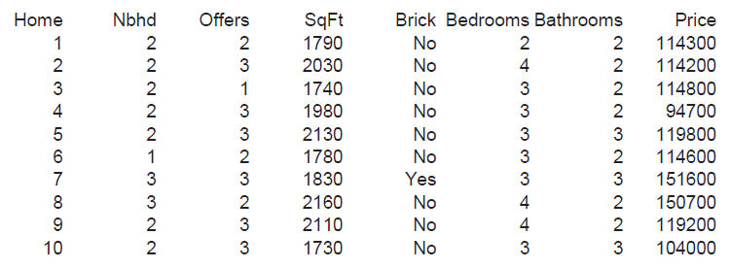


Price of Houses!
114.3
114.2
114.8
94.7
119.8
114.6
151.6
150.7
119.2
104
First 10 of a sample size of 1240 randomly selected houses.
nbeds = Bedrooms = number of bedrooms
nbath = Bathrooms = number of Bathrooms
Size = SqFt = square footage of the house in 1,000’s sqft.
Price = Price of the Home in $1,000s
nTrees = number of trees on the property

Slide 6
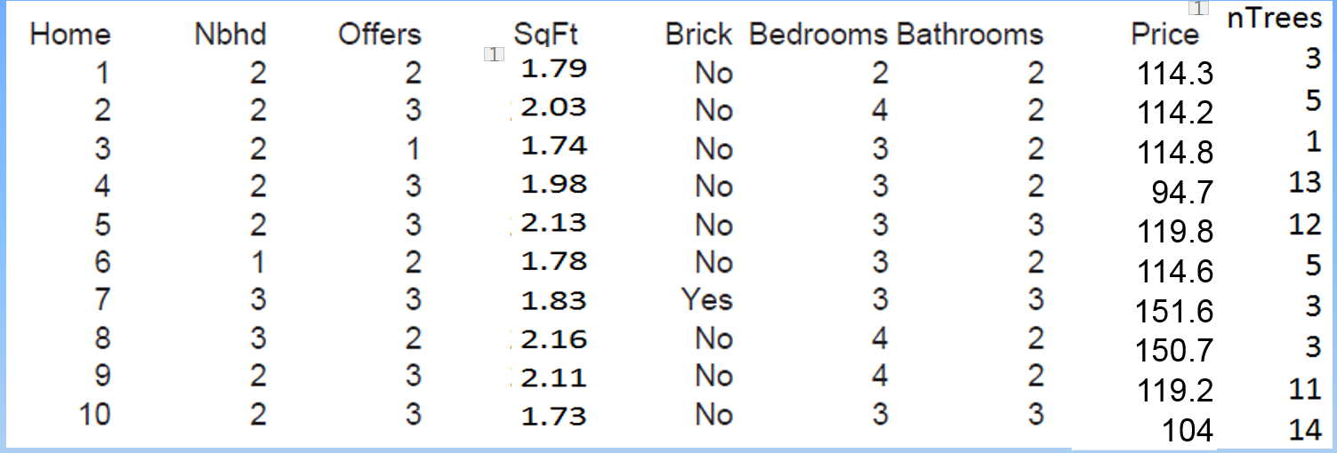
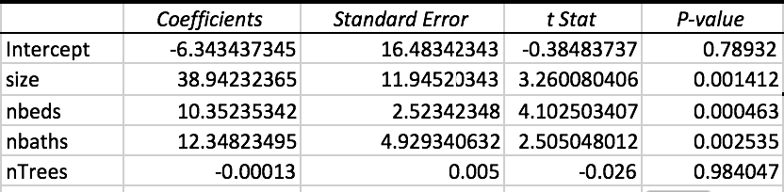
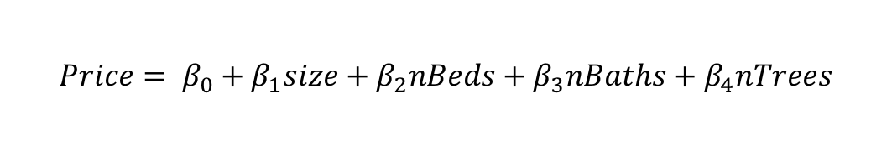
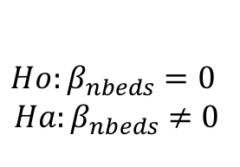
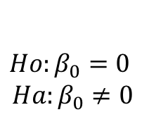
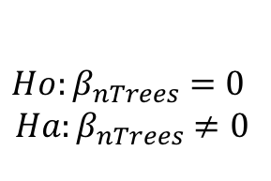
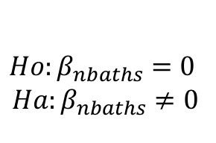
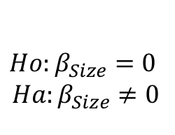
The Parameter Estimate Table: 5 Different Hypothesis Tests
$$Price= β_{0}+β_{1}size+β_{2}nBeds+β_{3}nBaths+β_{4}nTrees$$
$$Ho:β_{0}=0$$
$$Ha:β_{0}≠0$$
FTR Ho
$$Ho:β_{nbeds}=0$$
$$Ha:β_{nbeds}≠0$$
Reject Ho
$$Ho:β_{nTrees}=0$$
$$Ha:β_{nTrees}≠0$$
FTR Ho
$$Ho:β_{Size}=0$$
$$Ha:β_{Size}≠0$$
Reject Ho
$$Ho:β_{nbaths}=0$$
$$Ha:β_{nbaths}≠0$$
Reject Ho

Slide 7
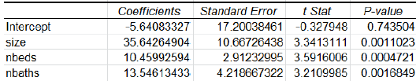
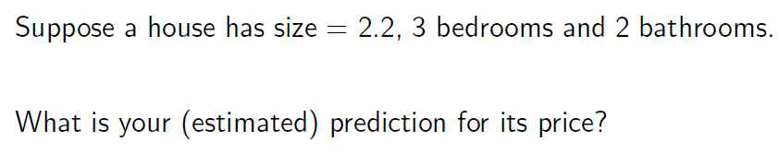

Multiple Regression: Prediction
Only include significant terms (slopes) in the final model. But for this class we will always include the intercept.
REFIT WITHOUT nTREES
This is the model we fit. Note that we have 4 parameters.
(β₀, β₁, β₂, β₃)
$$Price= β_{0}+β_{1}size+β_{2}nBeds+β_{3}nBaths+β_{4}nTrees$$

Slide 8
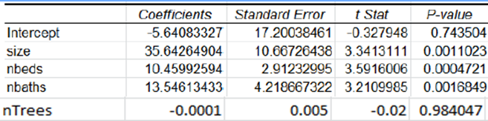
Multiple Regression: Prediction
Suppose a house has size 4.4 (4,400 ft²), 5 bedrooms and 4 bathrooms. What is the predicted price of the house?
-5.64 + 35.64 * 4.4 + 10.46*5 + 13.55 * 4 = 257.676
Our Prediction is $257,676!!!

Slide 9
Multiple Regression: Parameter Interpretation
With size and the number of bathrooms held fixed, how does adding one bedroom affect the estimated value of the house?
Answer: Holding all other variables held fixed, each additional bedroom increases the estimated value of the house by $10,460

Slide 10
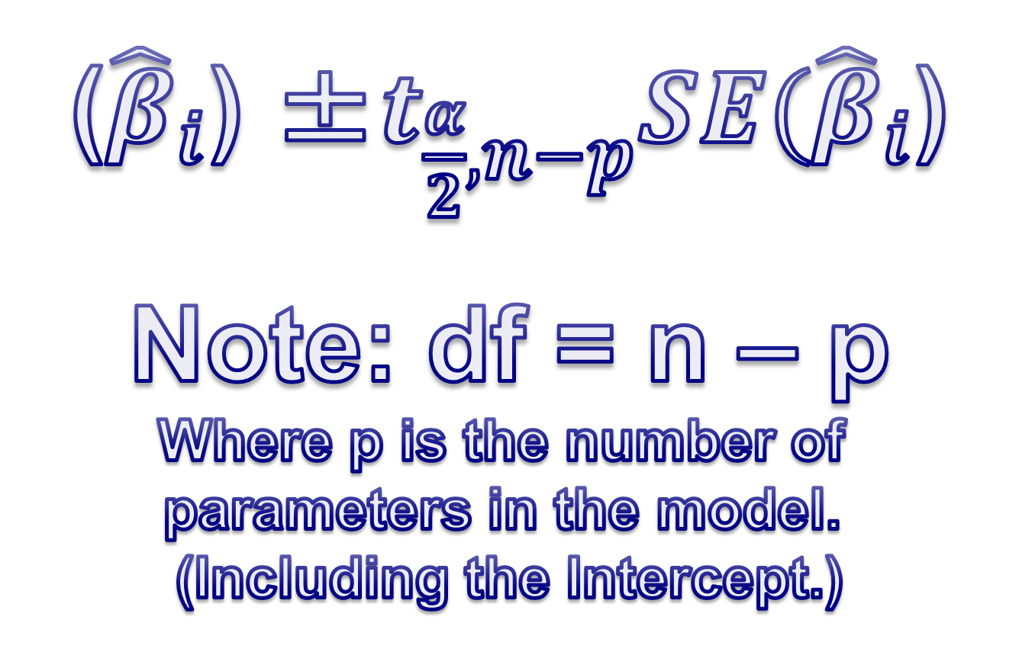
Confidence Intervals of Regression Parameters
(${\hat{β}}_{i}$) ±$t_{\frac{α}{2},n−p}SE({\hat{β}}_{i}$)
Note: df = n – p
Where p is the number of
parameters in the model.
(Including the Intercept.)

Slide 11
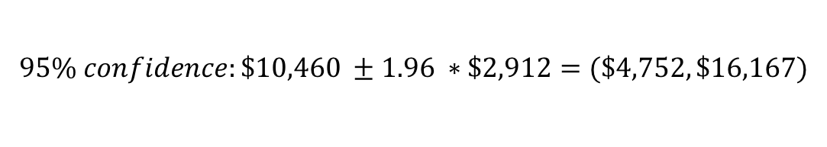
Multiple Regression: Parameter Interpretation
With size and the number of bathrooms held fixed, how does adding one bedroom affect the estimated value of the house?
Answer: For the same size house with the same number of bathrooms, each additional bedroom increases the estimated value of the house by $10,460
df = 1240-4 = 1236
$$95\% confidence:\$10,460 ±1.96 ∗\$2,912=(\$4,752,\$16,167)$$

Slide 12
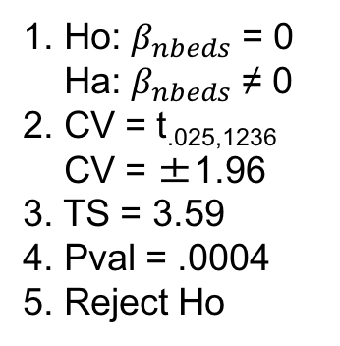

Multiple Regression: Hypothesis Testing
n = 1240
df = 1240 – 4
df =1236
Let’s become experts at reading this table!
You are actually looking at 5 different hypothesis tests!
Let’s look at the one for nbeds a little closer … others are analogous!
1. Ho: $β_{nbeds}$ = 0
Ha: $β_{nbeds}$ ≠ 0
1. Ho: $β_{nbeds}$ = 0
Ha: $β_{nbeds}$ ≠ 0
2. CV = t_{.025,1236}
CV = ±1.96
3. TS = 3.59
4. Pval = .0004
5. Reject Ho
6. There is strong evidence to suggest that the number of beds in a house is significantly linearly related to the estimated value of the house. (pval = .0004).
For each additional bedroom, holding the size and number of bathrooms fixed, we estimate that there is a $10,460 increase in the value of the house. A 95% confidence interval is ($4,752,$16,167).

Slide 13

Multiple Regression: Parameter Interpretation
$${\hat{β}}_{nbaths}=13.55. How do we interpret this?$$
Answer: Holding the size of the house and the number of bedrooms fixed,
each additional bathroom increases the predicted price of the house by $13,546.
$$95\% confidence:\$13,546 ±1.96 ∗\$4,219=(\$5,277,\$21,815)$$

Slide 14

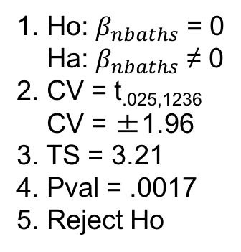
Multiple Regression: Hypothesis Testing
n = 1240
df = 1236
Coefficients in $1,000s
1. Ho: $β_{nbaths}$ = 0
Ha: $β_{nbaths}$ ≠ 0
1. Ho: $β_{nbaths}$ = 0
Ha: $β_{nbaths}$ ≠ 0
2. CV = t_{.025,1236}
CV = ±1.96
3. TS = 3.21
4. Pval = .0017
5. Reject Ho
6. There is strong evidence to suggest that the number of bathrooms in a house is linearly related to the estimated value of the house. (pval = .0017).
For each additional bathroom, for the same size and number of bedrooms, we estimate that there is a $13,546 (rounded) increase in the value of the house. A 95% confidence interval is ($5,277,$21,815).

Slide 15

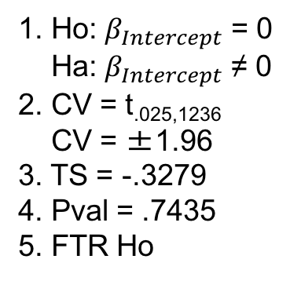
Multiple Regression: Hypothesis Testing
n = 1240
df = 1236
Coefficients in $1,000s
1. Ho: $β_{Intercept}$= 0
Ha: $β_{Intercept}$ ≠ 0
1. Ho: $β_{Intercept}$ = 0
Ha: $β_{Intercept}$ ≠ 0
2. CV = t_{.025,1236}
CV = ±1.96
3. TS = -.3279
4. Pval = .7435
5. FTR Ho
6. There is not sufficient evidence to reject the claim that the intercept is equal to zero. (pval = .7435). A 95% confidence interval is (-$39,352, $28,072).
$$95\% confidence: −\$5,640±1.96 ∗\$17,200=(−\$39,352, \$28,072)$$
Although it is extrapolation, does a zero intercept make practical sense here?

Slide 16
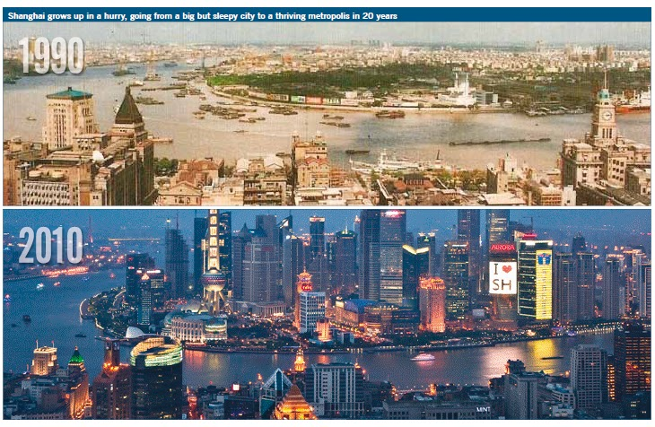
Hotels in China!!!

Slide 17
Hotels in China!

Slide 18

HOTELS IN CHINA!!!

Slide 19
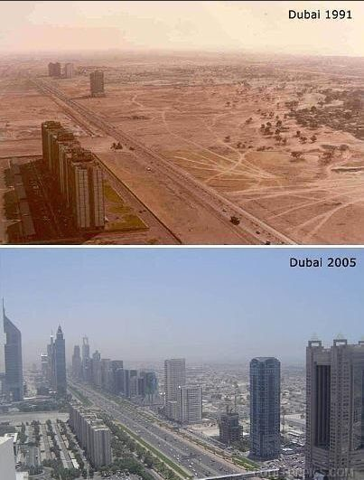
Hotels In Dubai!!!

Slide 20
Hotels in Dubai!!!

Slide 21
Hotels In Dubai!!!

Slide 22
Hotels in China!!!
Assume you just got a job as a VP of Operations for Hilton in China. Nice Work! You decided to try and save the company millions by using energy more efficiently. In order to do this, you decide to conduct a study to see if you can learn what factors affect the amount of energy consumed (Giga Watts) and what the relationship is between those factors and energy consumption. Use alpha = .1 for this study.

Slide 23
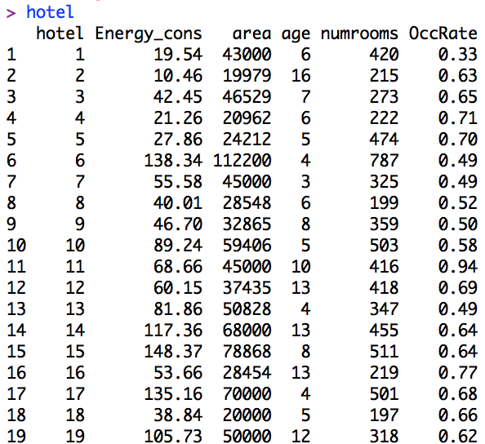
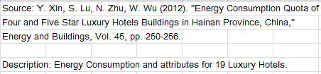
Hotels In China!!!

Slide 24
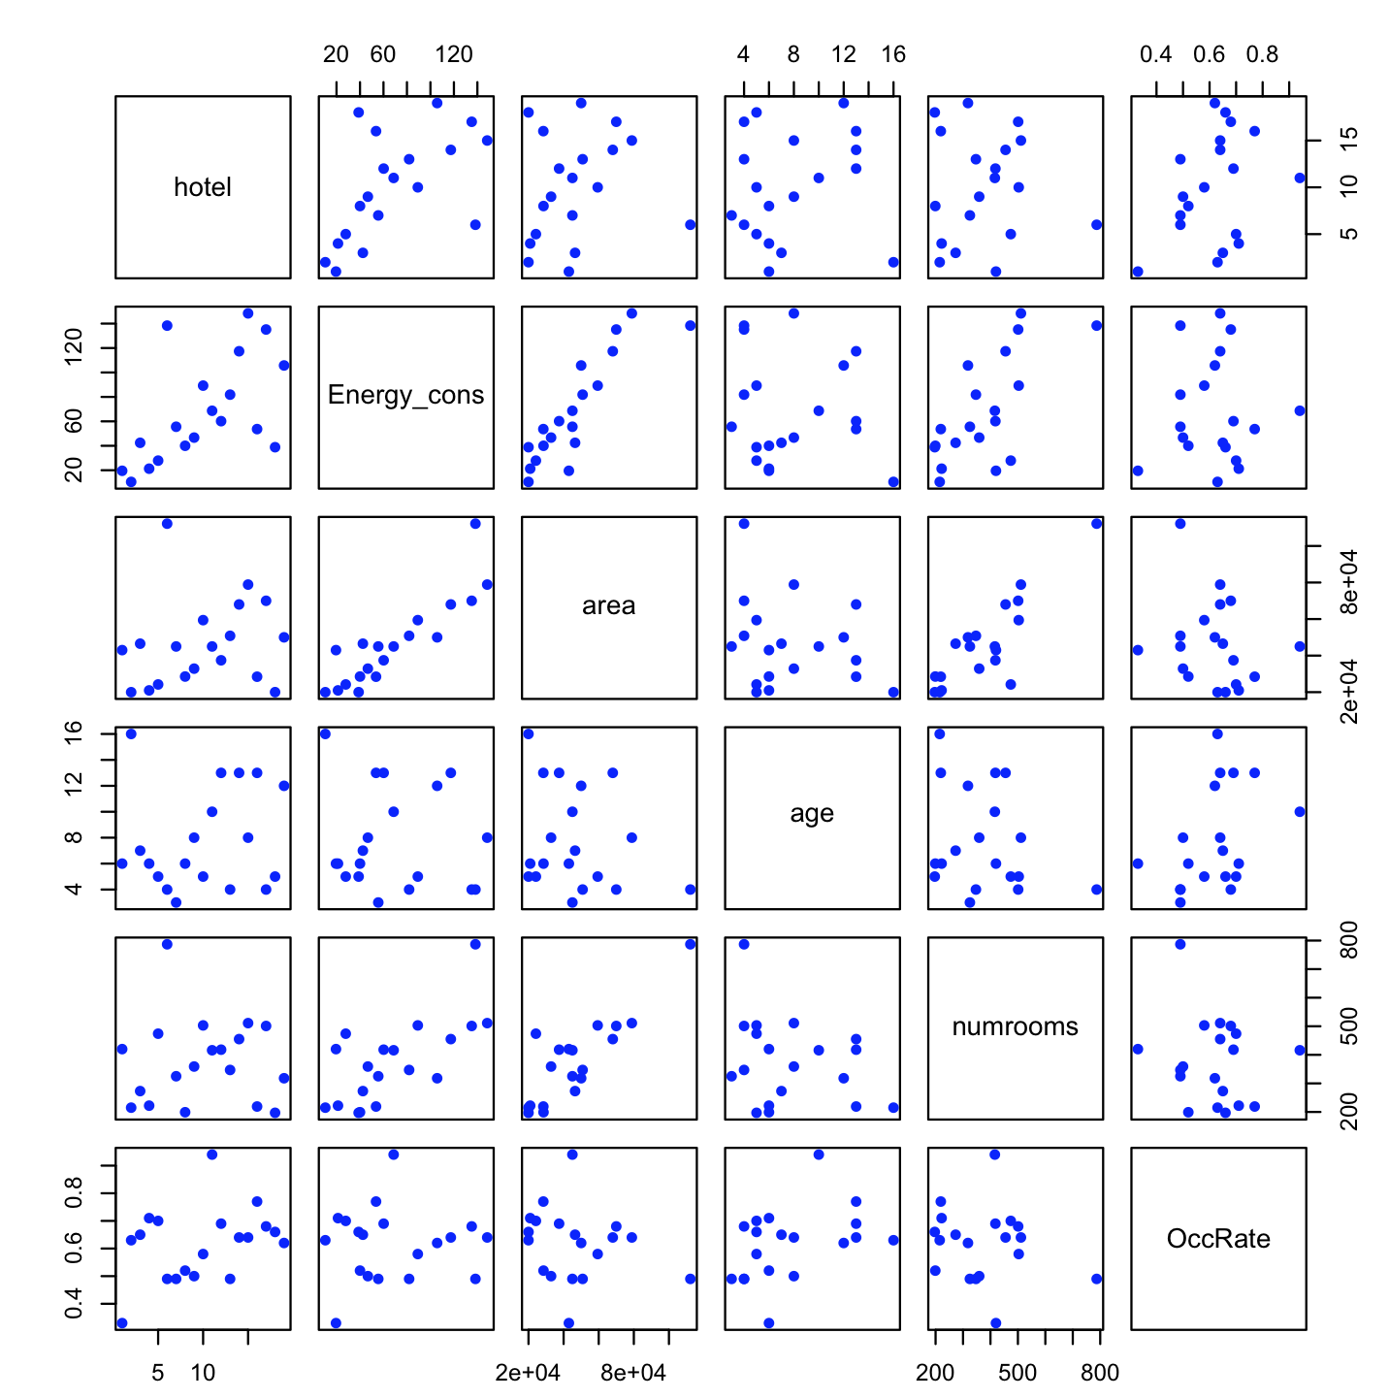
Plot the Data!!!

Slide 25
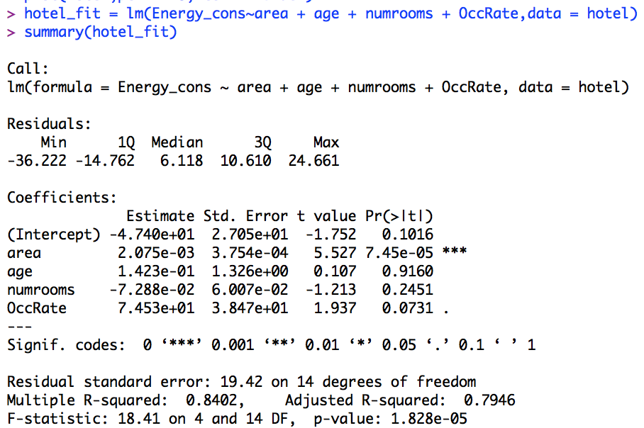
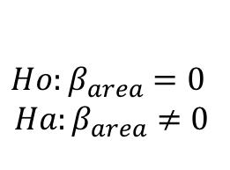
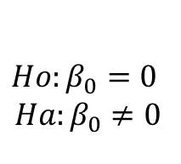
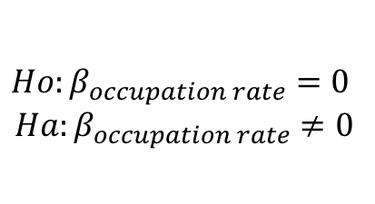
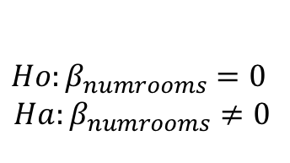
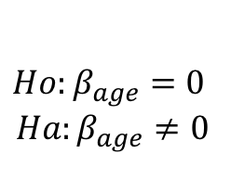
Hotels In China
Remember, this table represents 5 different hypothesis tests.
The formal null and alternative hypothesis of these tests are below.
$$Ho:β_{0}=0$$
$$Ha:β_{0}≠0$$
$$Ho:β_{area}=0$$
$$Ha:β_{area}≠0$$
$$Ho:β_{age}=0$$
$$Ha:β_{age}≠0$$
$$Ho:β_{numrooms}=0$$
$$Ha:β_{numrooms}≠0$$
$$Ho:β_{occupation rate}=0$$
$$Ha:β_{occupation rate}≠0$$
FTR Ho
Reject Ho
FTR Ho
FTR Ho
Reject Ho

Slide 26
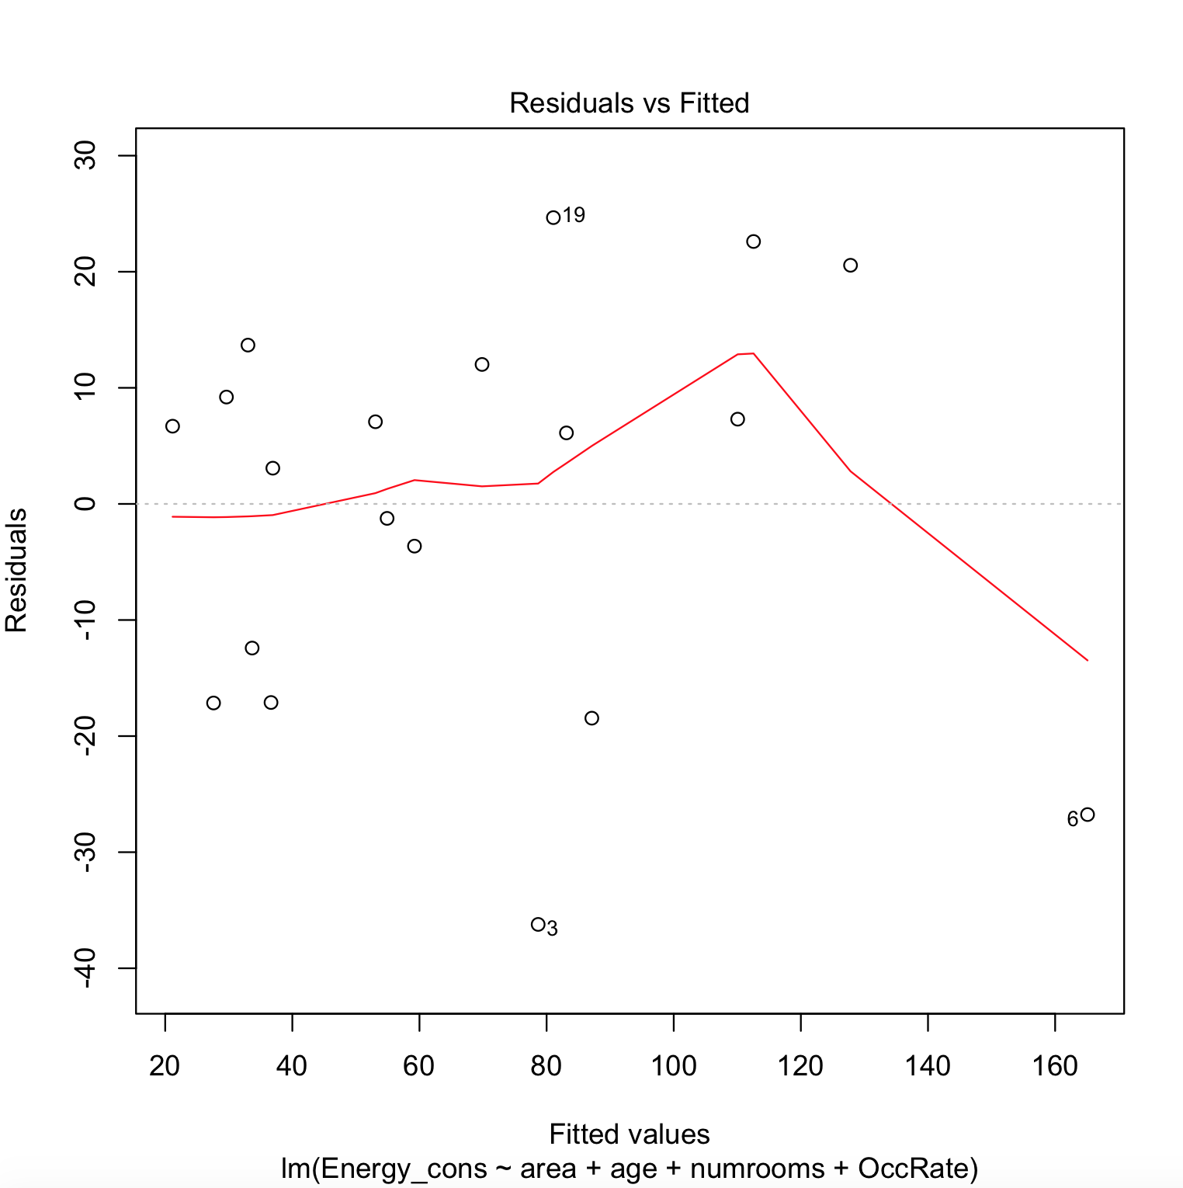
Check the Assumptions: Residuals
Residuals appear to be evenly scattered around zero.
There does not appear to be significant visual evidence against equal standard deviation in the residuals.
We will still assume the observations are independent.

Slide 27
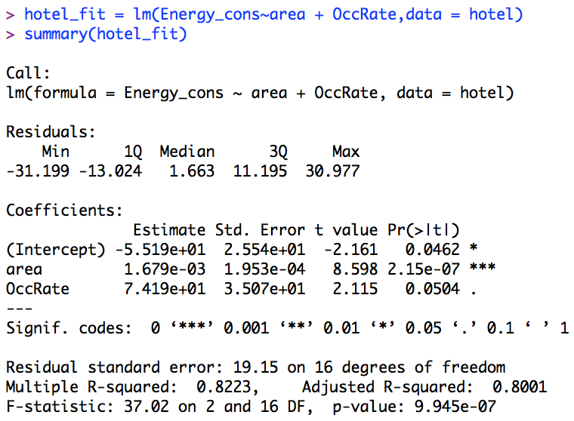
Hotels In China

Slide 28
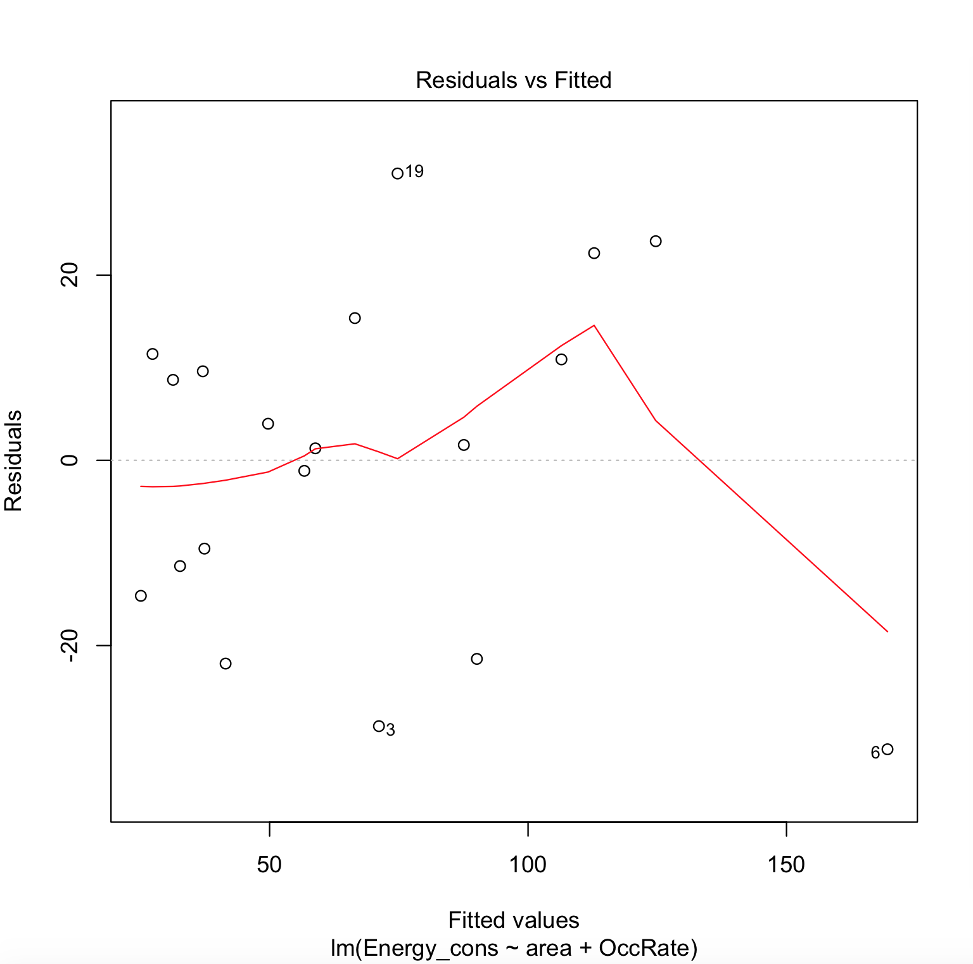
Check the Assumptions: Residuals
Residuals appear to be evenly scattered around zero.
There does not appear to be significant visual evidence against equal standard deviation in the residuals.
We will still assume the observations are independent.

Slide 29
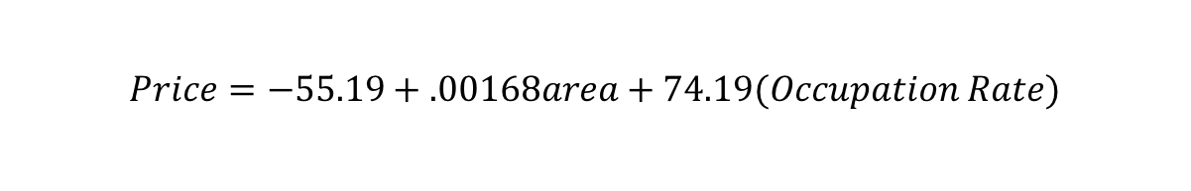
Hotels In China
Write down the model that was fit:
$$Price= β_{0}+β_{1}area+β_{4}Occupation Rate$$
Write down the final model (regression equation):
$$Price=−55.19+.00168area+74.19(Occupation Rate)$$

Slide 30
Hotels in China!!!
Assume you just got a job as a VP of Operations for Hilton in China. Nice Work! You decided to try and save the company millions by using energy more efficiently. In order to do this, you decide to conduct a study to see if you can learn what factors affect the amount of energy consumed (Giga Watts) and what the relationship is between those factors and energy consumption. For this study use an alpha = .1.

Slide 31
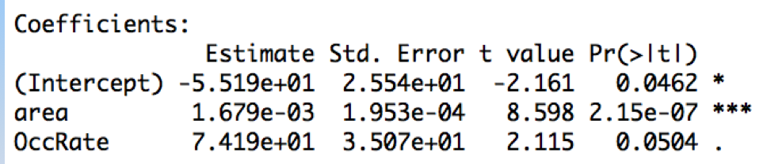
Hotels in China!!!
The analysis suggests that both area (pvalue < .0001) and the occupation rate (pvalue = .0504) are significant predictors of energy consumption.
The data suggest that for each additional sqft (holding all other variables fixed), the predicted consumption of energy of the hotel increases .00168 GWs.
A 90% confidence interval is:
(.00168 – t_{.05,16}(.000195), .00168 + t_{.05,16}(.000195))
= (.0013,.0020) GW.
The data suggest that for each additional percent of occupancy (holding all other variables fixed), the predicted consumption of energy of the hotel increases 74.19 GWs.
A 90% confidence interval is:
(74.19 – t_{.05,16}(35.07), 74.19 + t_{.05,16}(35.07))
= (12.96, 135.42) GW.
n = 19
df = 19 – 3
df =16

Slide 32
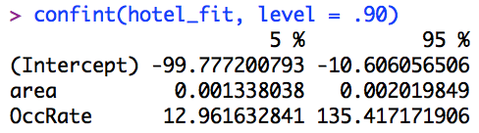
Hotels in China!!!
The analysis suggests that both area (pvalue < .0001) and the occupation rate (pvalue = .0504) are significant predictors of energy consumption.
The data suggest that for each additional sqft (holding all other variables fixed), the predicted consumption of energy of the hotel increases .00168 GWs.
A 90% confidence interval is:
(.00168 – t_{.05,16}(.000195), .00168 + t_{.05,16}(.000195))
= (.0013,.0020) GW.
The data suggest that for each additional percent of occupancy (holding all other variables fixed), the predicted consumption of energy of the hotel increases 74.19 GWs.
A 90% confidence interval is:
(74.19 – t_{.05,16}(35.07), 74.19 + t_{.05,16}(35.07))
= (12.96, 135.42) GW.
n = 19
df = 19 – 3
df =16

Slide 33
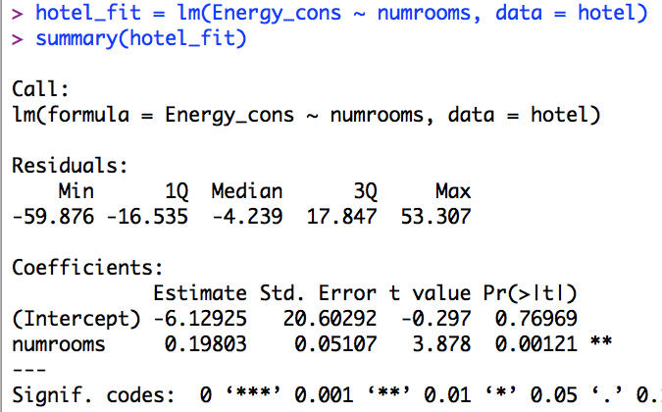
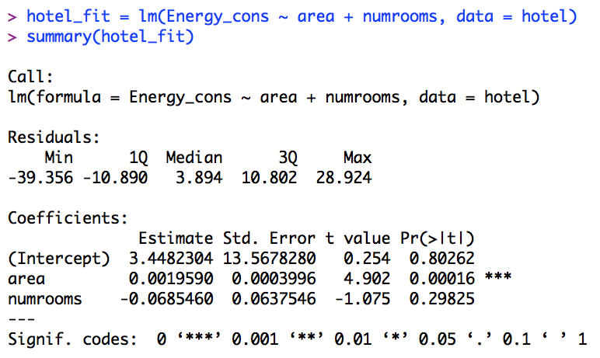
Note that this does not mean that other variables (like number of rooms) is not a significant predictor of energy consumption. It may be that the area variable accounts for the variation in energy consumption described by the number of rooms variable. (In short, number of rooms and area may provide the same information about energy consumption.

Slide 34
Note that this does not mean that other variables (like number of rooms) is not a significant predictor of energy consumption. It may be that the area variable accounts for the variation in energy consumption described by the number of rooms variable. (In short, number of rooms and area may provide the same information about energy consumption. When two explanatory variables are correlated this is known as multicollinearity.

Slide 35
MPG Analysis
Your goal is to assess the relationship, if any, between miles per gallon (MPG) and the horsepower, displacement and weight of the car.
You should plot the data with a matrix of scatter plots first to assess the assumptions for each variables relationship with MPG.
Then fit a multiple linear regression model with MPG as the response and interpret each slope with confidence intervals.
Finally, use your model to estimate the MPG of a car that weighs 2,600 lbs (2.6 K lbs), has 100 horse power and has a displacement of 160 cubic inches.

Slide 36
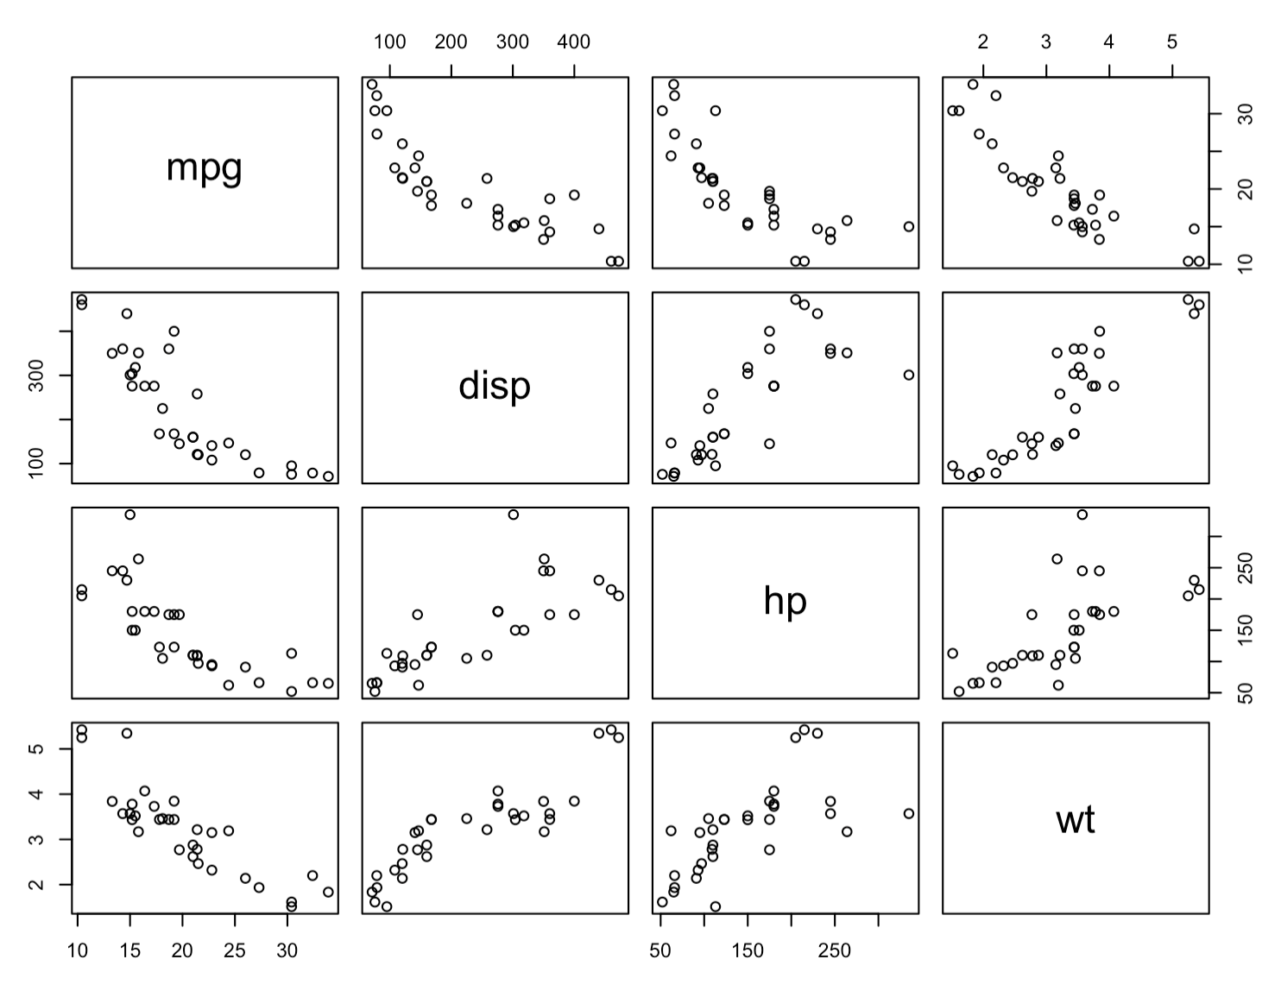
MPG Analysis
plot(mtcars[,c(1,3,4,6)])

Slide 37
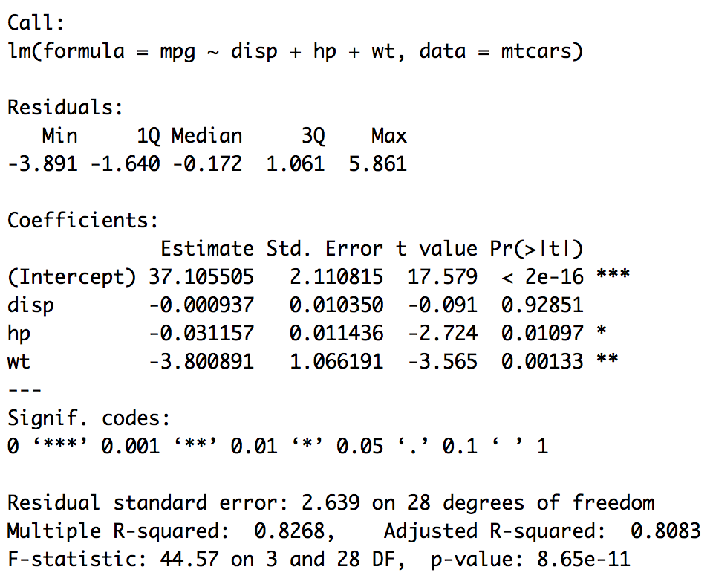
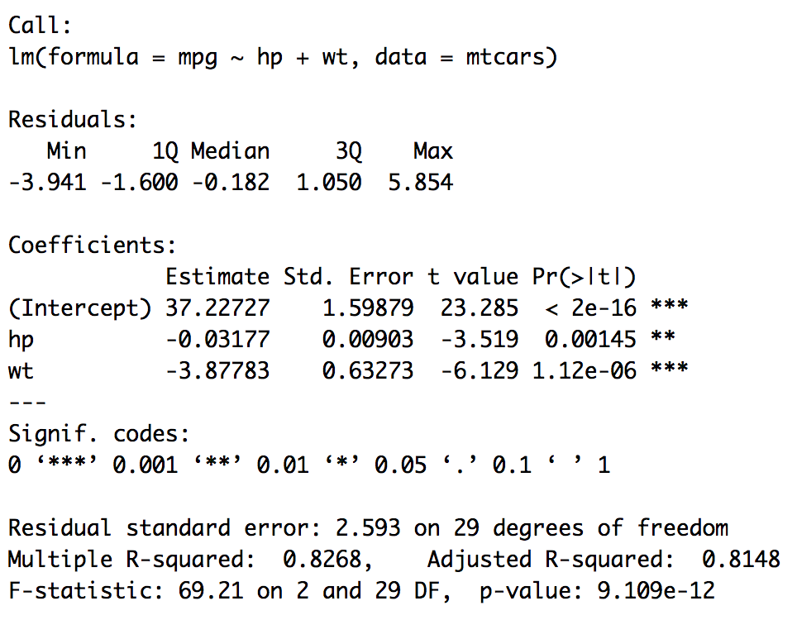
MPG Analysis
fit = lm(mpg~disp+ hp+wt,data = mtcars)
summary(fit)
fit = lm(mpg~hp+wt,data = mtcars)
summary(fit)

Slide 38
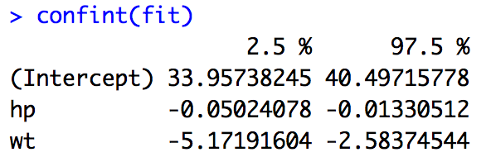
MPG Analysis
fit = lm(mpg~hp+wt,data = mtcars)
summary(fit)
The evidence suggests that we are 95% confident that for each 1 hp increase in horsepower, the mean miles per gallon decreases between .01 and .05 miles per gallon. Our best estimate is a decrease of .03 miles per gallon.
The evidence suggests that we are 95% confident that for each 1000 lbs increase in weight, the mean miles per gallon decreases between 2.6 and 5.2 miles per gallon. Our best estimate is a decrease of 3.9 miles per gallon.

Slide 39
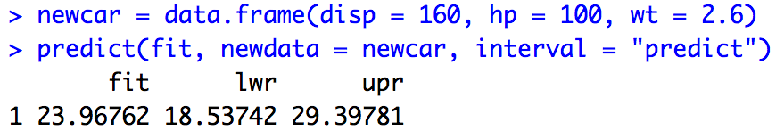
MPG Analysis
fit = lm(mpg~hp+wt,data = mtcars)
summary(fit)
confint(fit)
newcar = data.frame(disp = 160, hp = 100, wt = 2.6)
predict(fit, newdata = newcar, interval = "predict")
We are 95% confident that a single car with displacement 160 cubic inches, horsepower = 100 hp and and weight of 2,600 lbs, will get between 18.5 and 29.4 miles per gallon. Our best estimate is 23.97 miles per gallon.

